Slide 1
Mechanical Engineering Project
Water Collection System
Matthew Ernst
METC 107
Fall 2017

Slide 2
How a Water Collection System Works
Rainwater recycling involves collecting and reusing rainwater from a building’s roof or any other surface
The rainwater must pass through a filter, eliminating debris
The remaining water is then held in a storage tank, either underground or on the side of a building
This saved water can be pumped into places where it may be needed (bathroom, kitchen, laundry room, etc.)

Slide 3
How a Water Collection System Works cont.
The rainwater collected by most of these harvesting systems is usually not drinkable without substantial treatment
For safety measures, it is important that the collected rainwater be passed through a dedicated piping system and not the building’s drinking system
Most systems involve:
  Holding tank-hold the water
  Control unit-monitor the level of water in the tank
  Filter-stops debris
  Separate pipe system

Slide 4
Cost of Water Collection System
A do-it-yourself rain barrel system typically costs between $20-$50
Prefabricated rain barrels cost $70-$300 depending on size and capacity
A cistern is a water storage container made of metal, fiberglass, polyethylene (plastic), concrete, or wood, and can vary in cost depending on size and capacity
  150-350 gallons: $150-$650
  500-10,000 gallons: $500-$10,000
  Installation costs vary from $2,000-$20,000 or more depending on size, capacity, and various functions

Slide 5
Cost of Water Collection System cont.
A dry well is an underground structure designed to allow water to percolate into the water table (upper surface of zone of saturation)
A do-it-yourself dry well will cost $5-$50, whereas a prefabricated plastic dry well will cost around $90-$350
Installation of a dry well with all materials costs $300-$5,000

Slide 6
Disadvantages of a Water Collection System
Rainfall is hard to predict and it is not advised to depend on rainwater alone, especially for people who live in areas of little rainfall
A rainwater collection system may cost anywhere from $200-$2,000 depending on size and technology level and benefit cannot be derived until it is ready for use; cost recovers in 10-15 years depending on rainfall and sophistication of system
Water collection systems require regular maintenance in order to protect them from rodents, mosquitoes, algae growth, insects, etc.
Certain roof types may seep insects, dirt, or chemicals
Collection and storage facilities may limit the capacity of usable water; downpour water may escape; does not equal unlimited water supply

Slide 7
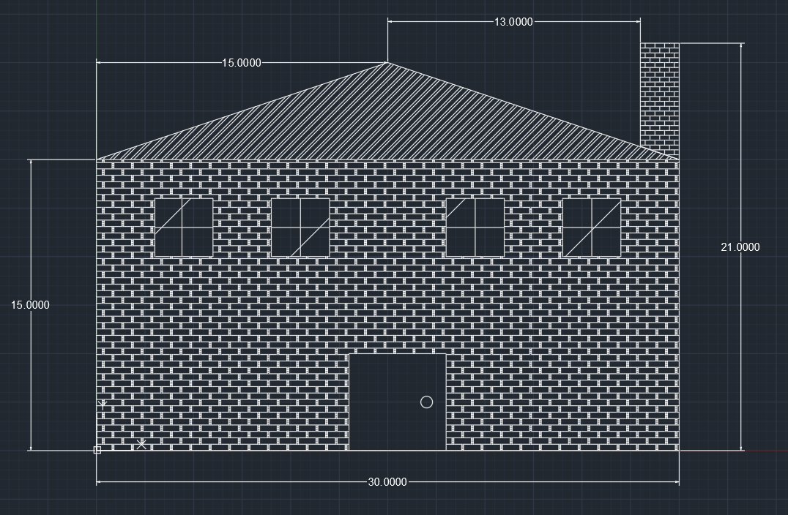
AutoCAD Drawings

Slide 8
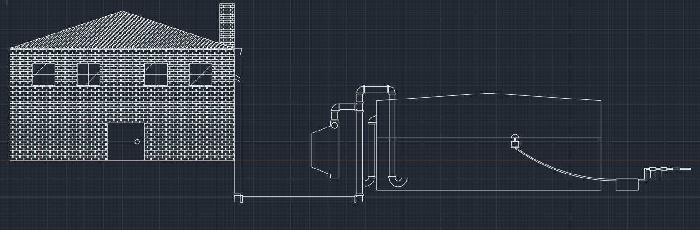
AutoCAD Drawings cont.
First flush diverter
Floating intake

Slide 9
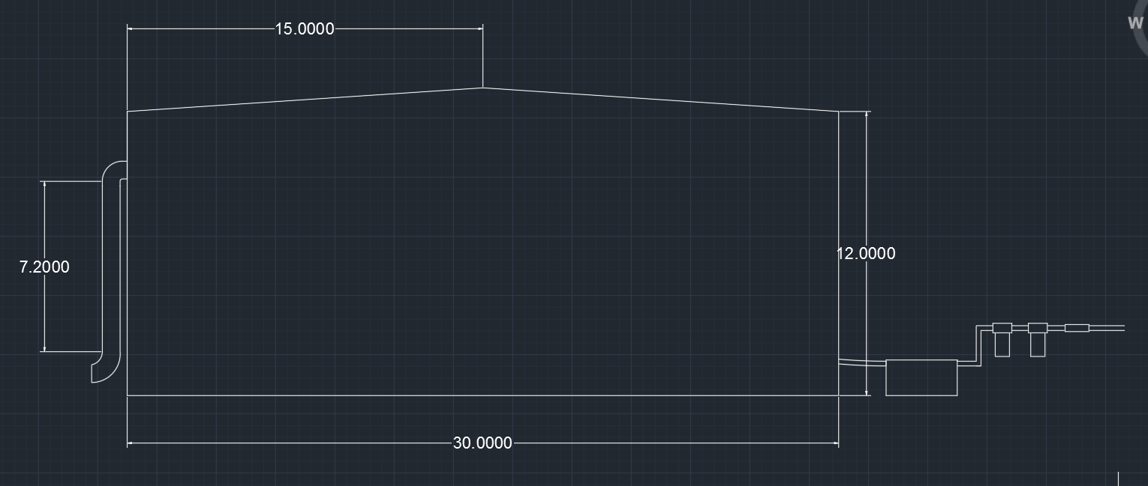
AutoCAD Drawings cont.

Slide 10
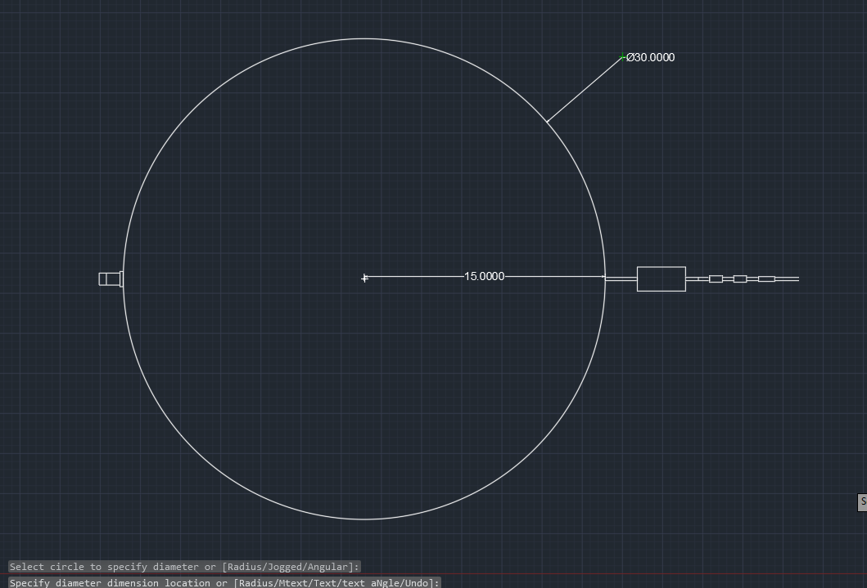
AutoCAD Drawings cont.

Slide 11
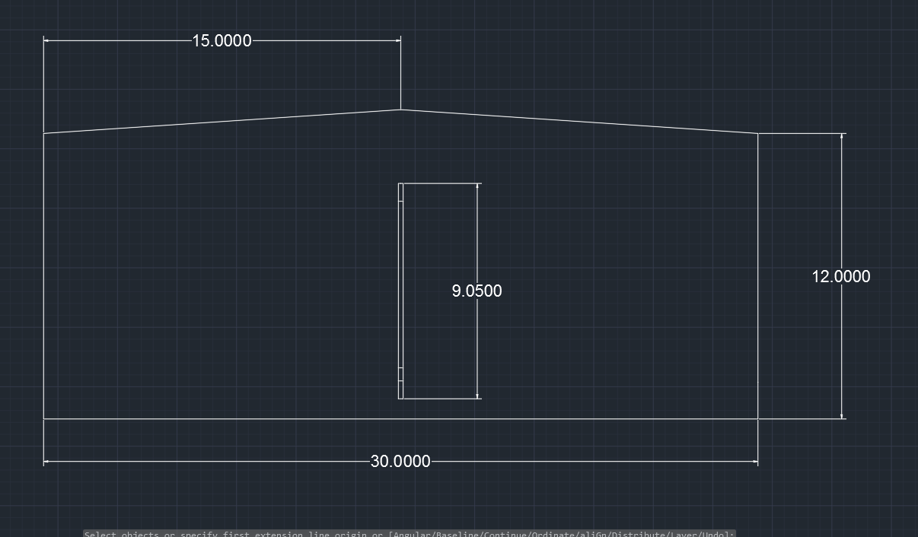
AutoCAD Drawings cont.

Slide 12
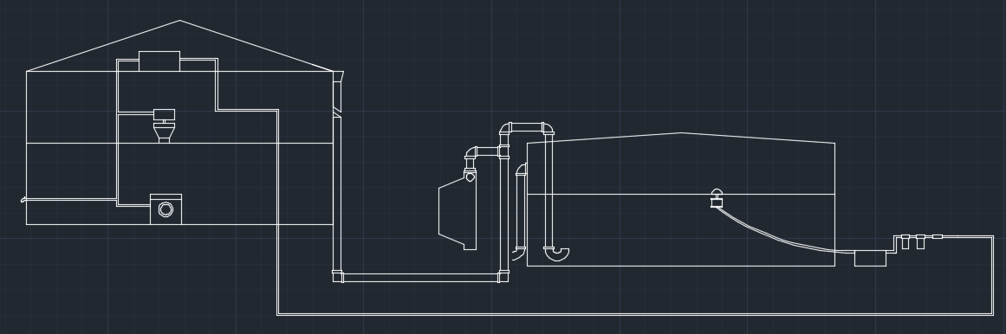
AutoCAD Drawings Cont.

Slide 13
Sources
https://www.renewableenergyhub.us/rainwater-harvesting-information/how-does-rainwater-recycling-work.html
http://home.costhelper.com/rain-harvesting.html
https://www.conserve-energy-future.com/advantages_disadvantages_rainwater_harvesting.php

